Slide 1

Automotive Technology: A Systems Approach, 8e
Chapter 53: Antilock Brake, Traction Control, and Stability Control Systems
Rob Thompson and Jack Erjavec, Automotive Technology: A Systems Approach, 8th Edition. © 2025 Cengage. All Rights Reserved. May not be scanned, copied or duplicated, or posted to a publicly accessible website, in whole or in part.

Slide 2
Chapter Objectives (1 of 2)
53.01 Explain how antilock brake systems work to bring a vehicle to a controlled stop.
53.02 Describe the differences between an integrated and a nonintegrated antilock brake system.
53.03 Describe the operation of the major components of an antilock brake system.

Slide 3
Chapter Objectives (2 of 2)
53.04 Describe the operation of the major components of automatic traction and stability control systems.
53.05 List the precautions to follow when working on an antilock brake system.
53.06 Explain the common procedures for finding ABS faults.

Slide 4
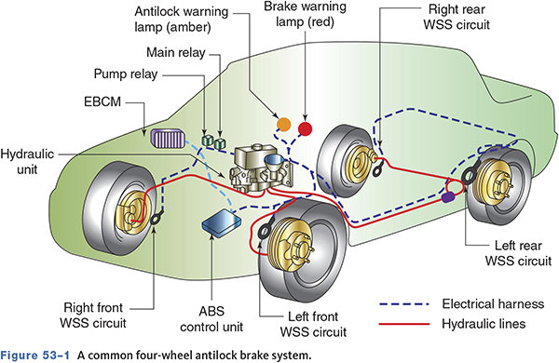
Basic ABS Brakes

Slide 5
Antilock Brakes
53-01 Explain how antilock brake systems work to bring a vehicle to a controlled stop.
The ABS system pulses the brakes more rapidly than the driver can.
Pulsing the brakes prevents wheel lockup.
Preventing wheel lockup provides for more stable stopping.
Preventing wheel slip allows the wheels to turn as directed.

Slide 6
Pressure Modulation
If the wheels lock, the vehicle will slide.
Pumping the brakes allows the driver to maintain control.
When the ABS pumps the brakes, it is called pressure modulation.
The ABS can modulate brake pressure up to 15 times per second.

Slide 7
Knowledge Check (1 of 3)
Technician A says a wheel with 0 percent slip is locked up.
Technician B says a wheel with 100 percent slip is locked up.
Who is correct?

Slide 8
Knowledge Check Answer (1 of 3)
Technician A says a wheel with 0 percent slip is locked up.
Technician B says a wheel with 100 percent slip is locked up.
Who is correct?
Answer: Technician B only

Slide 9
Pedal Feel
Different than a non-ABS equipped vehicle
When the ABS activates, a small bump followed by rapid pedal pulsations
The pedal may drop lower than normal under ABS braking.

Slide 10
Hydraulic Components
53-03 Describe the operation of the major components of an antilock brake system.
Accumulator
  Stores fluid to maintain high pressure and provide residual pressure for power-assist
Control Valve Assembly
  Controls the release and application of brake system pressure to the wheel brake assemblies
Booster Pump
  Provides pressurized hydraulic fluid for the ABS system

Slide 11
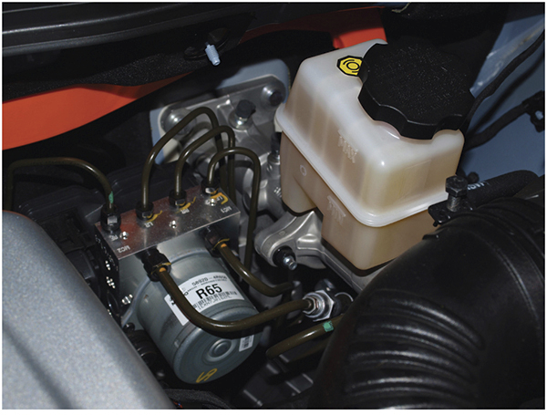
Accumulators

Slide 12
Hydraulic Components (1 of 2)
Fluid Accumulator
  Stores fluid that is removed from the wheel circuits during the ABS cycle
Hydraulic Control Unit
  Contains solenoid valves, fluid accumulators, pump, and electric motor in one unit
Booster/Master Cylinder Assembly
  Contains the valves and pistons used to modulate hydraulic pressure

Slide 13
Hydraulic Components (2 of 2)
Modulator Unit
  Controls the flow of fluid to the individual wheel circuits
Hydraulic Valves
  Control and direct hydraulic pressure
    Solenoid valves
    Main valve
    Wheel circuit valves

Slide 14
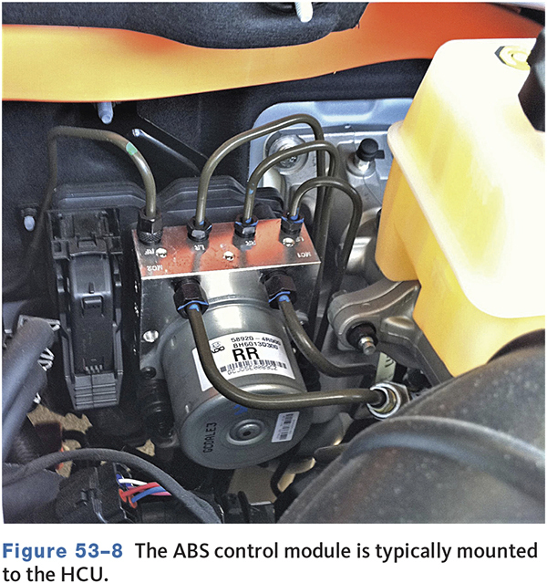
Electrical/Electronic Components (1 of 5)
Control Module
  Controls ABS operation and monitors the system

Slide 15
Electrical/Electronic Components (2 of 5)
Brake Pedal Sensor
  Signals the control module when the brake is applied
Data Link Connector (DLC)
  Provides access to and/or control of vehicle information

Slide 16
Electrical/Electronic Components (3 of 5)
Indicator Lights
  All vehicles have a red brake.
  A separate light is used for ABS faults.
Lateral Position Sensor
  Is used on some systems to monitor sideways movement of the vehicle

Slide 17
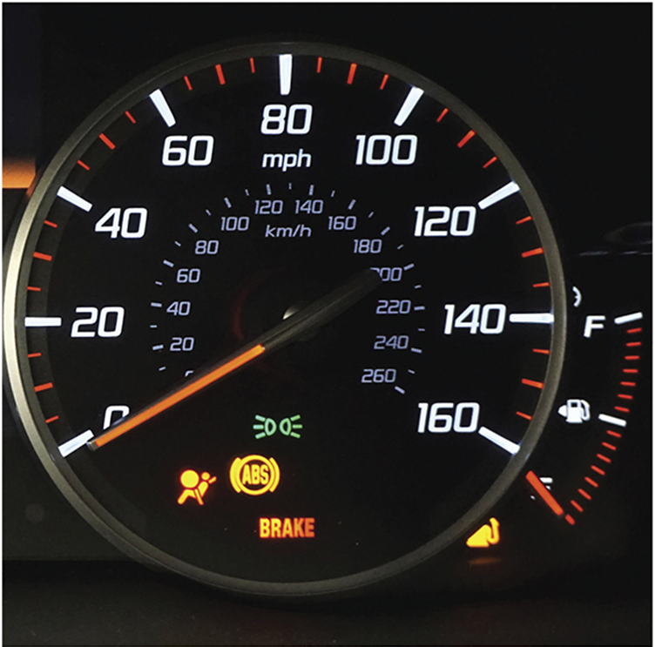
Electrical/Electronic Components (4 of 5)

Slide 18
Electrical/Electronic Components (5 of 5)
Pressure Switch
  Controls pump operation and the low pressure warning lamp
Pressure Differential Switch
  Sends a signal to the control module when there is an undesirable difference of pressure at the wheel brake units
Wheel Speed Sensors
  Sends wheel speed information to the ABS module
  May generate an AC or DC signal

Slide 19
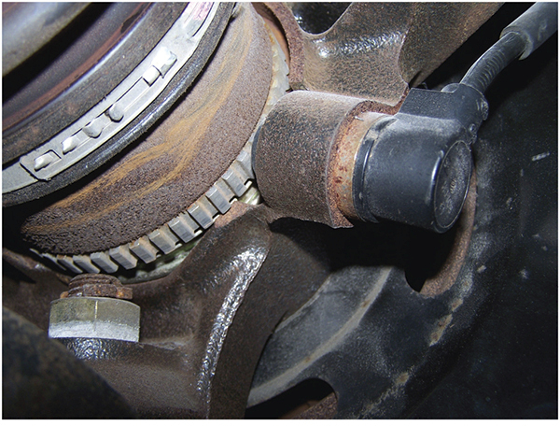
Wheel Speed Sensors

Slide 20
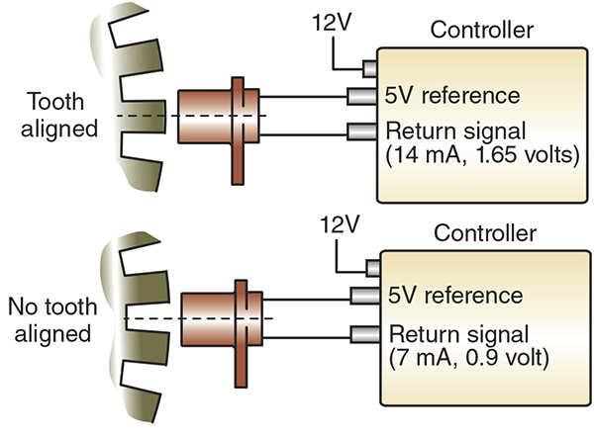
Active Sensors

Slide 21
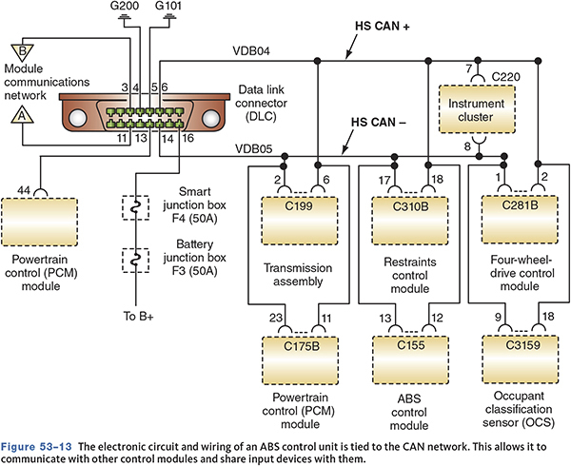
ABS Is Part of the CAN Network

Slide 22
Basic ABS Operation
The ABS control module calculates the slip rate of the wheels and controls the brake fluid pressure to certain wheel brakes to reach the target slip rate.
If the control module senses that a wheel is about to lock, based on input sensor data, it pulses the normally open inlet solenoid valve closed for that circuit.

Slide 23
ABS Types
53-02 Describe the differences between an integrated and a nonintegrated antilock brake system.
Integral
  Combines the master cylinder, power booster, and ABS hydraulic circuitry in one unit
Non-Integral
  Uses a conventional power booster and master cylinder
  The electrohydraulic control unit may be mounted to the master cylinder or remotely.

Slide 24
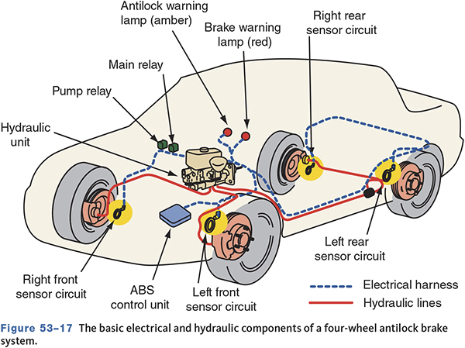
Typical Four-Wheel ABS System

Slide 25
Knowledge Check (2 of 3)
Which of the following is not a common ABS configuration?
  One-Channel
  Two-Channel
  Three-Channel
  Four-Channel

Slide 26
Knowledge Check Answer (2 of 3)
Which of the following is not a common ABS configuration?
  One-Channel
  Two-Channel
  Three-Channel
  Four-Channel
  Answer: Two-Channel

Slide 27
ABS Operating Modes
Pressure Hold (retaining)
  No additional pressure is allowed to reach the brake.
Pressure Release (decrease)
  Pressure is released so the wheel can turn.
Pressure Apply (increase)
  Brake pressure is reapplied to the affected brake.

Slide 28
Adaptive Braking
Many vehicles are equipped with an electronic brake-assist system.
  Can prepare or apply the brakes based on operating conditions.
Many systems can determine if an emergency braking event is occurring.
  Uses input from multi-axis acceleration sensors, forward-facing cameras, and/or radar signals

Slide 29
Automatic Traction Control (ATC) (1 of 2)
53-04 Describe the operation of the major components of automatic traction and stability control systems.
ATC systems apply the brakes when a drive wheel attempts to spin or lose traction.
ABS controls negative wheel slip.
ATC controls positive wheel slip.
ATC is most helpful on four-wheel and all-wheel drive vehicles.

Slide 30
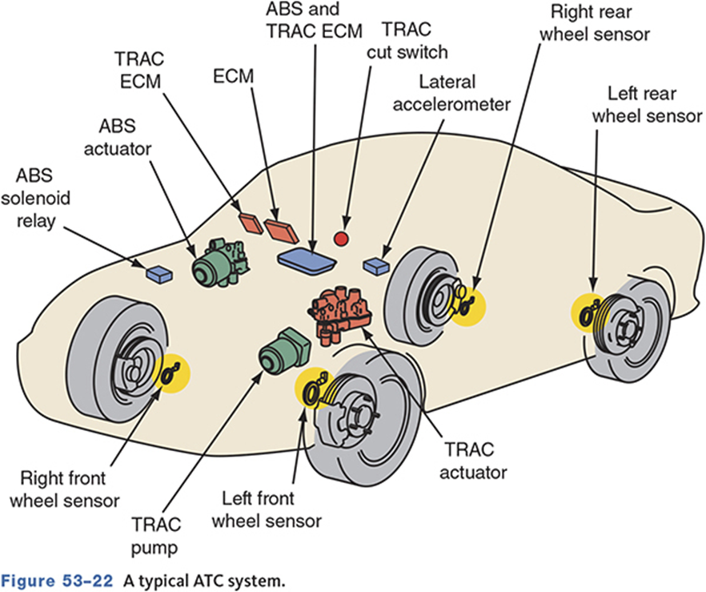
Automatic Traction Control System

Slide 31
Automatic Traction Control (ATC) (2 of 2)
Monitors wheel speed sensors.
If a wheel loses traction, the ATC module applies braking force to that wheel.
May use separate hydraulic controls than the ABS or may be integrated with ABS
Some ATC systems only function at low speed.

Slide 32
Engine Controls
More advanced ATC systems work at high speeds.
If wheel slip is detected, the PCM may reduce torque to the drive wheels by
  Retarding spark timing
  Reducing or cutting of fuel injectors
  Increasing EGR flow
  Upshifting the transmission

Slide 33
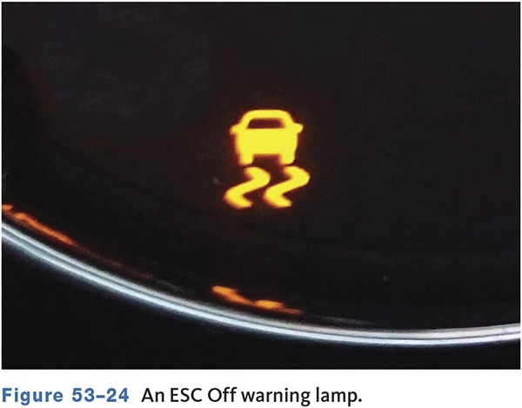
Driver Controls and Indicators
Most have two warning lights.
  If an ABS disabling fault occurs, the ATC is also disabled.
Some vehicles have an ATC cut-off switch.

Slide 34
Automatic Stability Control or Electronic Stability Control (ESC)
Linked with the ABS
May be linked with the electronic suspension system
Helps prevent skids, swerves, and rollovers by helping the driver maintain control

Slide 35
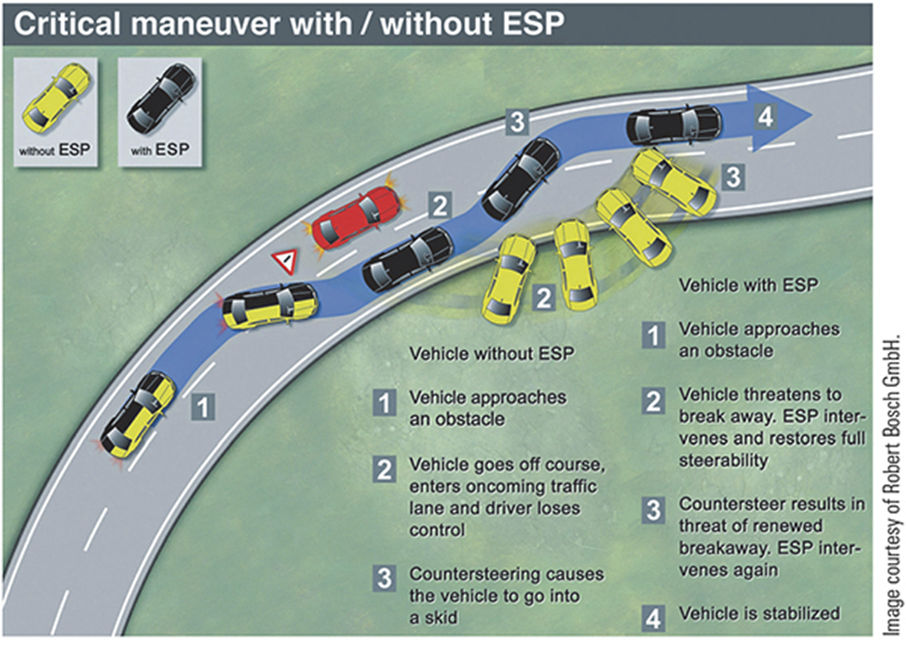
Electronic Stability Control Operation
The control unit monitors lateral acceleration, yaw rate, and brake pressure.

Slide 36
ABS Service
53-05 List the precautions to follow when working on an antilock brake system.
Most service is identical as with a conventional brake system.
Always refer to the recommended procedures before attempting to service brakes on an ABS-equipped vehicle.
Normal brake repairs are performed as usual.

Slide 37
Service Safety Precautions (1 of 2)
Always use lines and hoses designed for ABS vehicles.
Never use silicone brake fluid in an ABS system.
Always follow the proper bleeding procedure.
Never open a bleeder screw with the system pressurized.

Slide 38
Service Safety Precautions (2 of 2)
Never disconnect or reconnect electrical connectors with the ignition switch on.
Do not install electronic accessories near any control module.
Keep the wheel speed sensors clean.
Never use a hammer to install speed sensor toothed rings.

Slide 39
Relieving Accumulator Pressure
Accumulator pressure can be as high as 2,800 psi (19,300 kPa).
Before servicing, relieve system pressure
Common method includes
  Turn the ignition off
  Pump the brake pedal 25 to 50 times
Procedures vary—always refer to the service manual

Slide 40
Diagnosis and Testing
53-06 Explain the common procedures for finding ABS faults.
Types of testing may include the following:
  Pre-diagnostic inspections and test drive
  Warning light symptom troubleshooting
  On-board ABS control module (trouble code) testing
  Individual trouble code and component testing
Following the wrong sequence or bypassing steps may lead to unnecessary replacement of parts or incorrect resolution of the symptom.

Slide 41
Prediagnostic Inspection
Observe the red brake and amber ABS lights.
Check fluid level.
Inspect hoses, lines, and fitting for leaks or damage.
Inspect all brake components.
Check for loose wheel bearings.
Check outer CV joint alignment.
Check tire tread depth.
Check electrical connections for corrosion and damage.
Inspect wheel sensors and wiring.

Slide 42
Self-Diagnostics
A malfunction will cause the control module to shut off the ABS system.
A self check is performed at each start-up.
Each system has specific diagnostic modes and procedures.
Always refer to the manufacturers service information

Slide 43
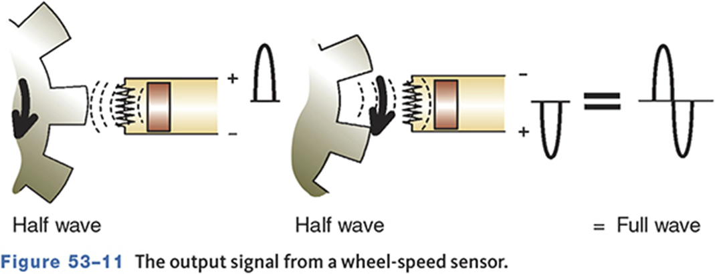
Testing with a Lab Scope
A critical ABS and TCS input is the wheel speed sensor signal.
AC generators should produce even and clean AC signals at each wheel.
Some vehicles use Hall-effect wheel speed sensors that produce digital square wave signals.

Slide 44
Wheel Speed Sensor Service
Inspect for chipped or crack pulser teeth.
Use a feeler gauge to measure the air gap.
Inspect for rust and metal buildup on the sensor.
PM generator sensor wiring is twisted pair and not serviceable.

Slide 45
Knowledge Check (3 of 3)
Technician A says ABS systems may require special bleeding procedures.
Technician B says integral systems may require depressurizing the system before service.
Who is correct?

Slide 46
Knowledge Check Answer (3 of 3)
Technician A says ABS systems may require special bleeding procedures.
Technician B says integral systems may require depressurizing the system before service.
Who is correct?
Answer: Both Technicians A and B

Slide 47
New Trends
Electric Calipers
  Computer controlled to evenly distribute braking power to all four wheels
Brake-by-wire
  The braking command is electronically processed and the master cylinder controlled
Electronic Wedge Brake (EWB)
  Completely electronic

Slide 48
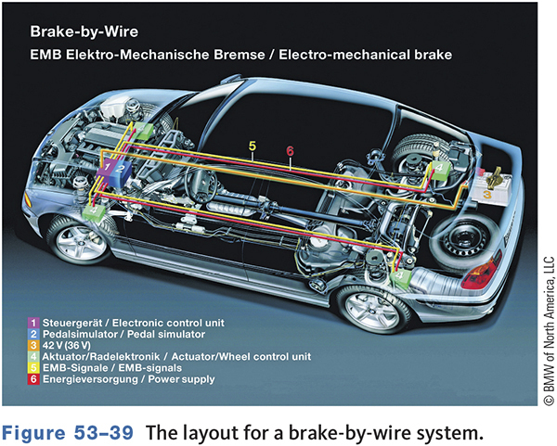
Brake-by-Wire
Hybrids and EVs use brake-by-wire technology.
Brake pedal sensors determine driver intent.
Stroke simulators are used to simulate “normal” brake feel.

Slide 49
Chapter Reflection
State a concept from this chapter that challenged you the most. Describe what made the concept difficult for you and the steps you took to improve your understanding. How could you help another student who was struggling with the same concept?
Use 100–150 words in your answer.

